Slide 1
[ecs + jobs] The Rain God
Joshua Issac

Slide 2
The game
The game consists of a Rain God (Snowman).
You press Space to spawn rain that falls. As you spawn more rain, the land gets affected – resulting in flooding.
There are also a bunch of moving entities that like to walk around for the lulz.

Slide 3
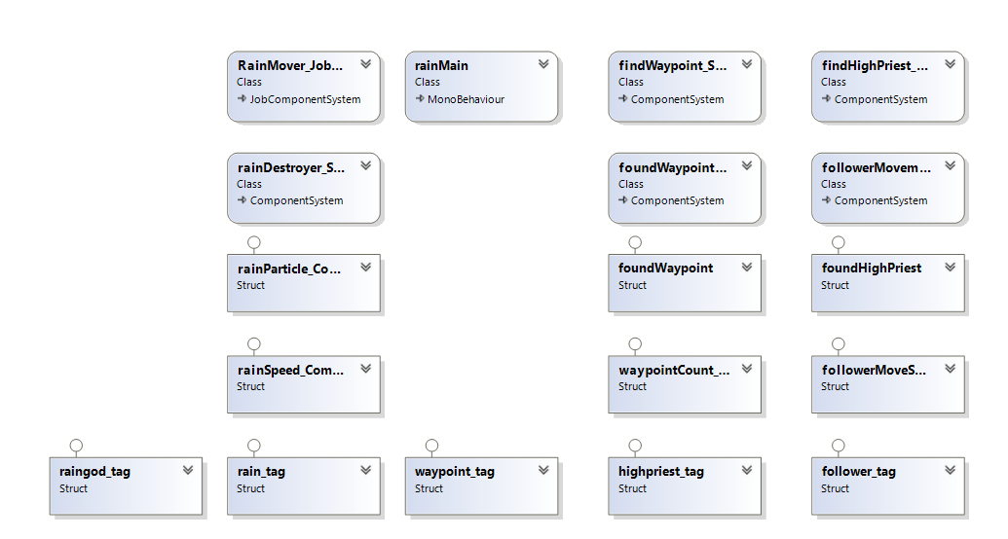
Class Diagram

Slide 4
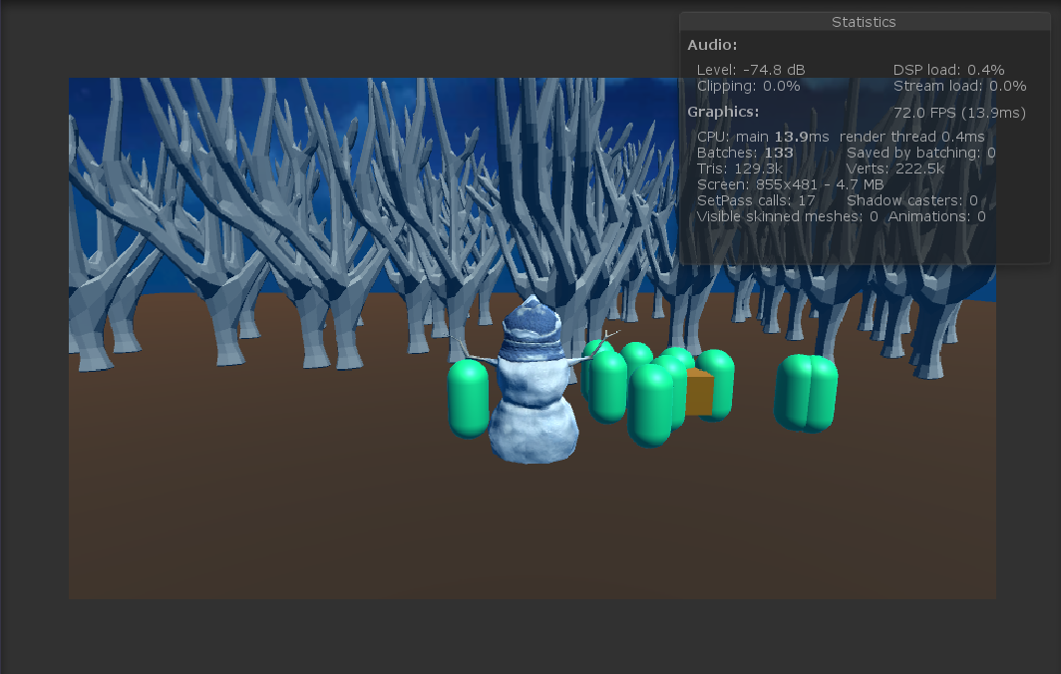
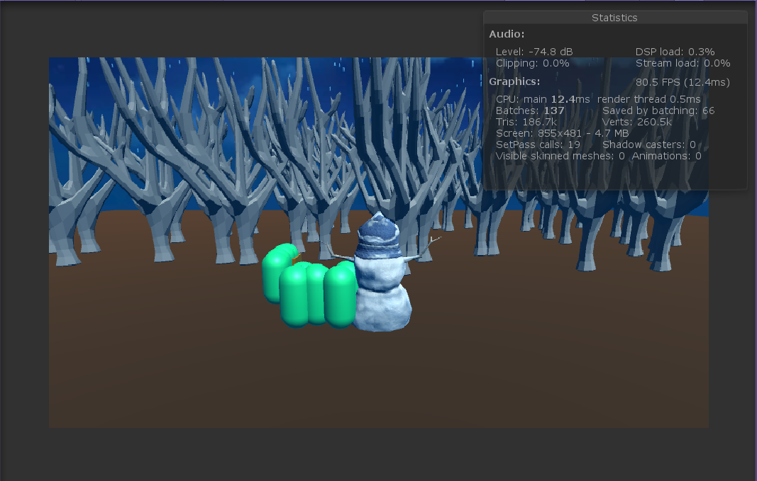

Slide 5
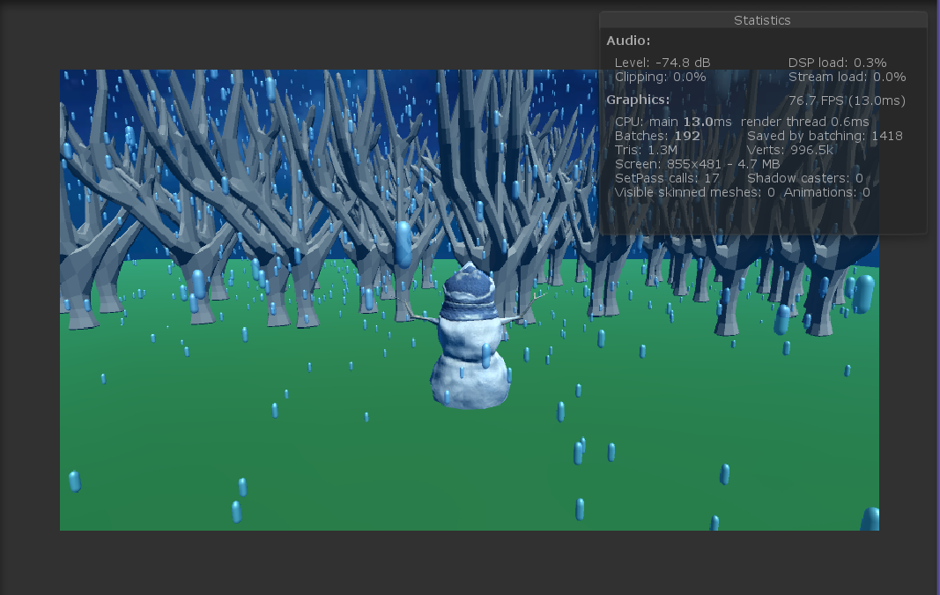
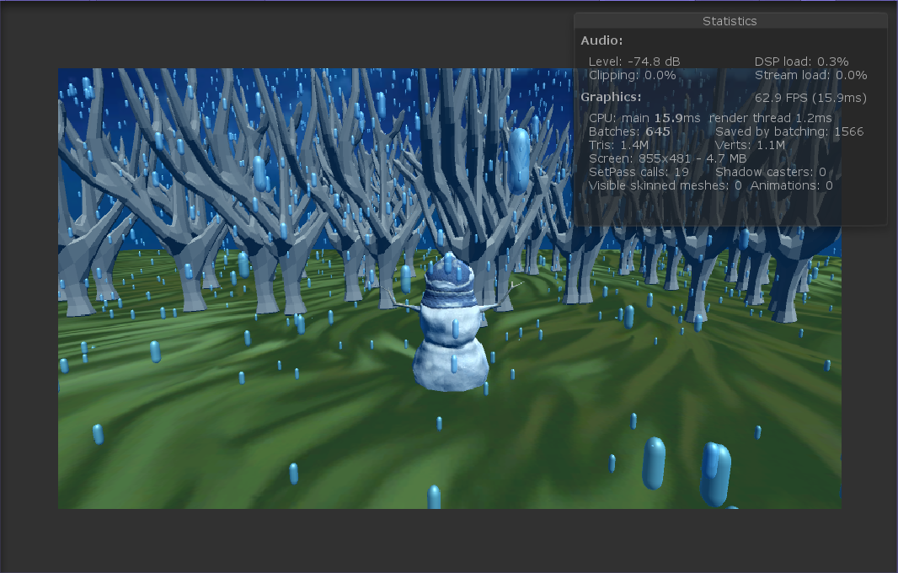

Slide 6
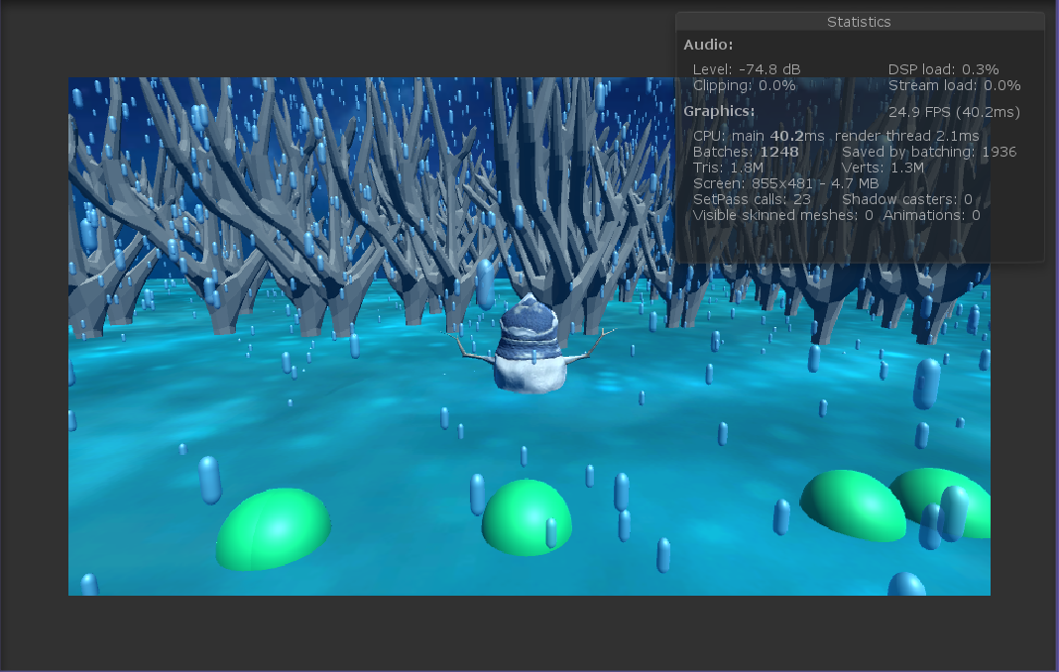

Slide 7
Entities
1) The Rain God
2) Waypoints
3) The High Priest (Yellow Cube) & The Followers (Green Capsules)
4) Land
5) Trees
6) Rain

Slide 8
Components
1) Tags: rain_tag, waypoint_tag, highpriest_, follower_tag , raingod_tag
2) foundHighPriest – This component is added to a follower when it “locates” the High Priest.
3) foundWaypoint – This component is added to the High Priest when it “locates” the closest Waypoint. It is removed when the found Waypoint is destroyed.
4) rainParticle_Component – Contains a Particle ID number. (Doesn’t play a role in the game)
5) rainSpeed_Component – Contains a rainMoveSpeed float that determines the speed of the raindrops that fall.
6) waypointCount_Component – Waypointcount keeps track of the number of waypoints visited.
7) followerMoveSpeed_Component – Contains a float that determines the movement speed of the follower.

Slide 9
systems
1) RainMover_JobSystem
2) rainDestroyer_System
3) findWaypoint_System
4) foundWaypointDebug_System
5) PriestMovement_System
6) findHighPriest_System
7) followerMovement_System

Slide 10
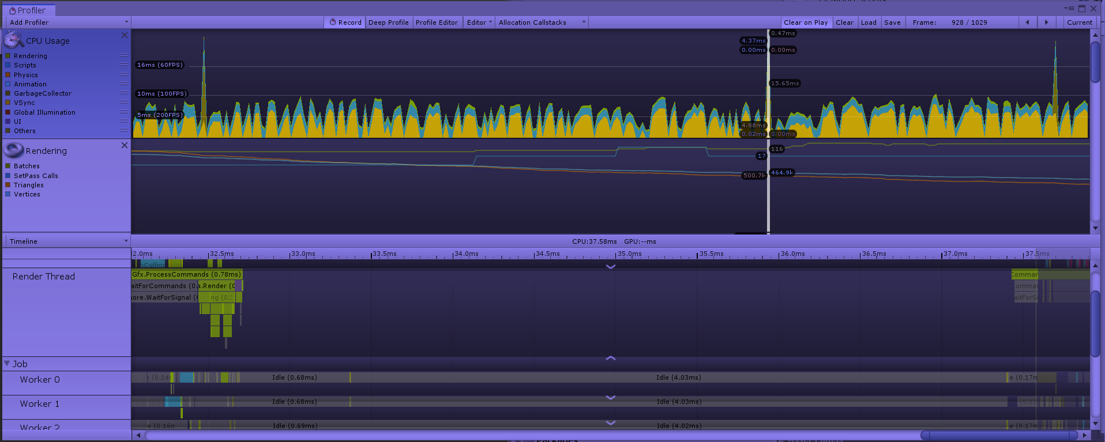
profiling

